Slide 1

FSHARPING #2
Úvod do světa F# (pohledem C# vývojáře)
Roman Provazník
@dzoukr
www.fsharping.cz
@fsharping

Slide 2



Slide 3

F#

Slide 4


Don Syme

Slide 5
Multi-paradigm
Statically typed
OCaml syntax

Slide 6




Slide 7


F#
C#

Slide 8




Slide 9




Slide 10


Slide 11
The Power of F#

Slide 12
Type inference

Slide 13
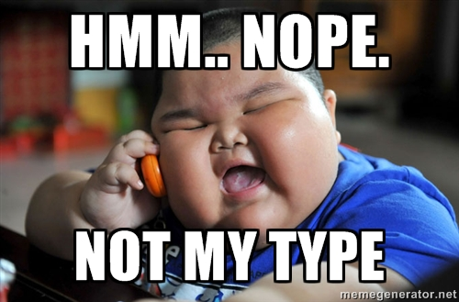

Slide 14
Immutability

Slide 15
Immutability is overrated,
but no one will change it

Slide 16
Easy to test

Slide 17
Hard to screw

Slide 18
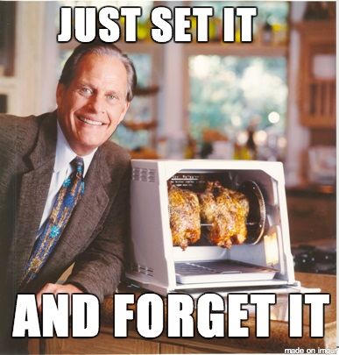

Slide 19
No NULL

Slide 20
Say it again!

Slide 21
No

Slide 22
NULL

Slide 23
Clean code

Slide 24
C#
{{{{{{{{;;;code;;;; }}}}}}}}

Slide 25
F#
code

Slide 26
Less code = Less noise

Slide 27
Less code = Less names

Slide 28
StatelessDataSourceRollbackFactory
AbstractDefaultJavaModelProxy
InternalNamespaceSelectionSingleton

Slide 29


Slide 30
Naming is HARD

Slide 31
The length of a name should be related to the length of scope

Slide 32
Anonymous functions

Slide 33

Combine all paradigms!

Slide 34
OOP + FP = faster learn

Slide 35
REPL

Slide 36
Read-Evaluate-Print Loop

Slide 37
Use debugger only for bugs

Slide 38
Faster development

Slide 39
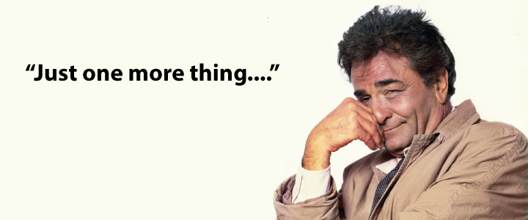

Slide 40
$$$

Slide 41
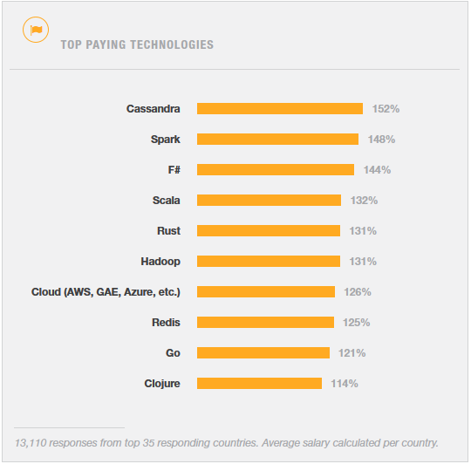
http://stackoverflow.com/research/developer-survey-2015

Slide 42
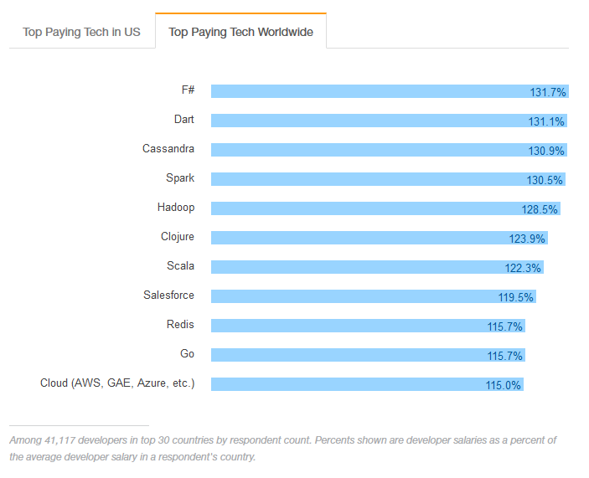
http://stackoverflow.com/research/developer-survey-2016#technology-top-paying-tech

Slide 43
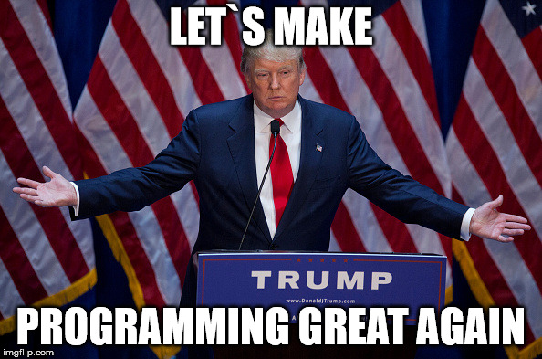

Slide 44
Let`s start with F#

Slide 45
.fs vs .fsx

Slide 46
module vs namespace

Slide 47

Babica rule

Slide 48

If you don`t know, use module

Slide 49
DEMO #1 Simple function

Slide 50

F# cool features

Slide 51
Tuple

Slide 52
Data structure with N elements

Slide 53
Ideal as lightweight function return value

Slide 54
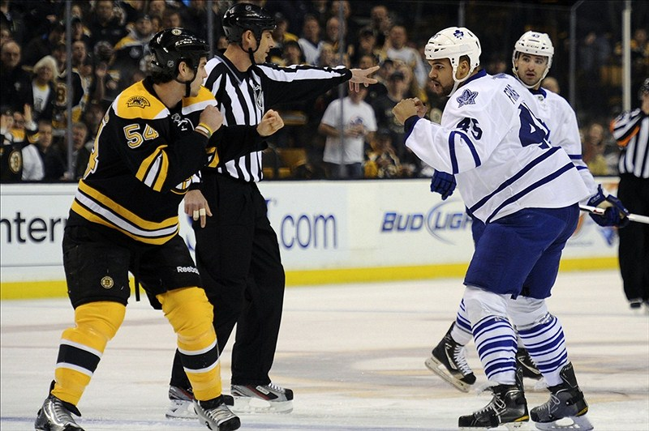

Slide 55
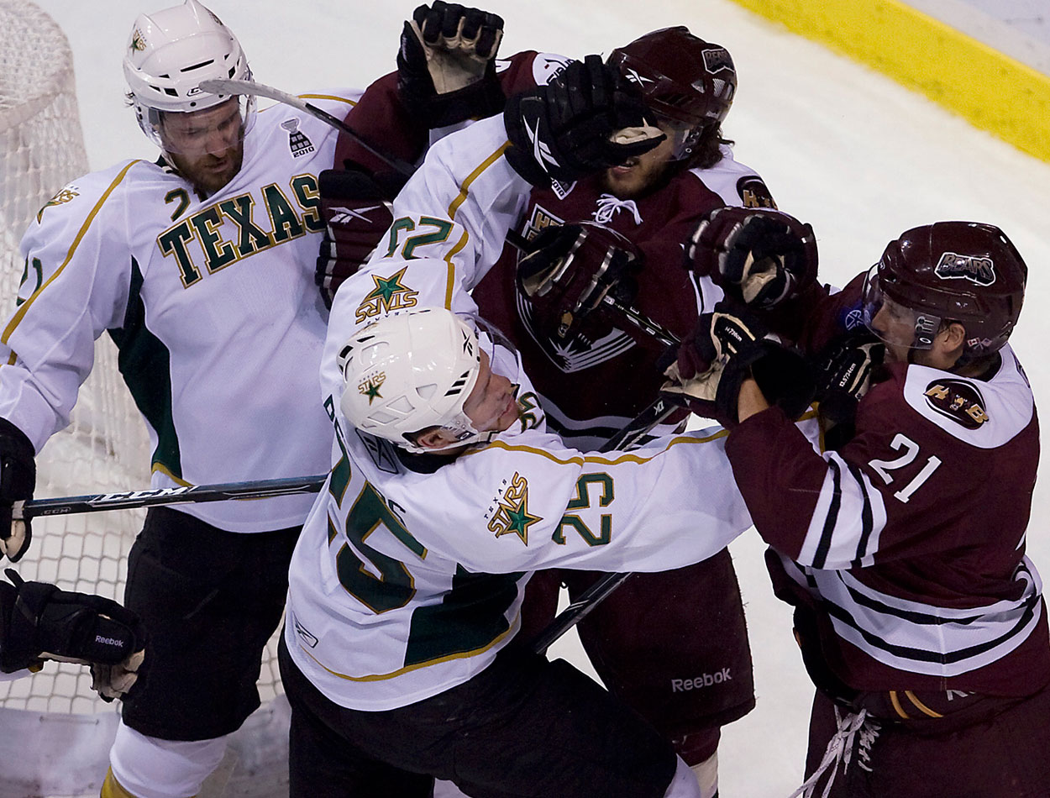

Slide 56
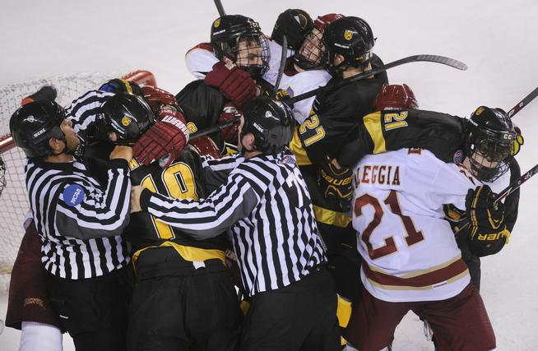

Slide 57
DEMO #2 Tuples

Slide 58
Lists

Slide 59
F# list <> .NET List class

Slide 60
Immutable by default

Slide 61
Essential type for FP

Slide 62
DEMO #3 Lists

Slide 63
Functions

Slide 64
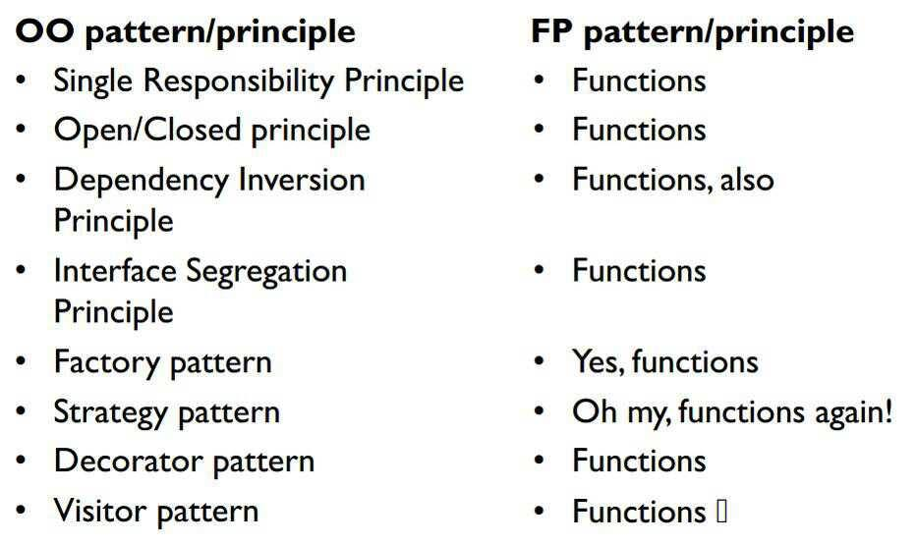
http://blog.cleancoder.com/uncle-bob/2014/11/24/FPvsOO.html

Slide 65
DEMO #4 Functions

Slide 66
Option

Slide 67
Do you remember NULL?

Slide 68


Slide 69
Use Option

Slide 70
Some(value)

Slide 71
None

Slide 72
Nothing else

Slide 73
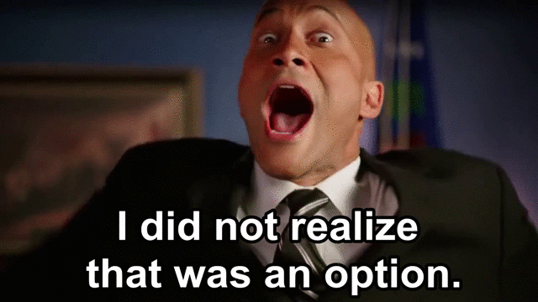

Slide 74
DEMO #5 Options

Slide 75
Pattern Matching

Slide 76
Best. Thing. Ever.

Slide 77
SWITCH (on heavy drugs)

Slide 78
Is everywhere in F#

Slide 79
DEMO #6 Pattern Matching

Slide 80
Discriminated Unions

Slide 81
Another essential type

Slide 82
Pattern Matching Support

Slide 83
Enum (on even heavier drugs)

Slide 84
Value that can be exactly one case

Slide 85
DEMO #7 Discriminated Unions

Slide 86
Records

Slide 87
Great for grouping data into structured format

Slide 88
Immutable by default

Slide 89
But easy to clone

Slide 90
Cannot be inherited

Slide 91
Structural comparison and equality

Slide 92
Pattern Matching Support

Slide 93
“.” notation access

Slide 94
DEMO #8 Records

Slide 95
Unit

Slide 96
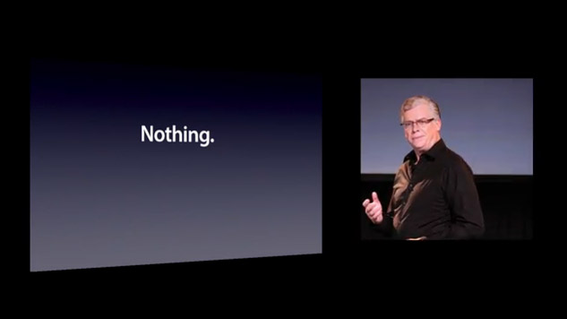

Slide 97
()

Slide 98
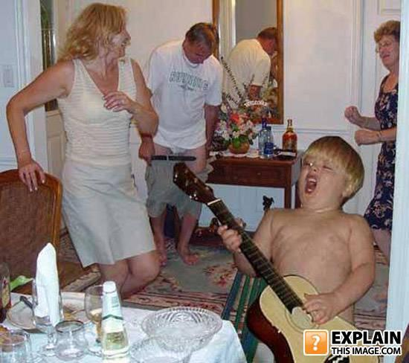
Even cooler features

Slide 99
Operators

Slide 100
|>

